Slide 1
PROJECT RECAP
Settings and PRN reading (Davide)
Binary file reading (Mattia)
Downconvertion and filter (Gabriele)
Signal acquisition (Marcello)
Demodulation and CRC (Lorenzo)
Tracking system (Davide & Lorenzo)
Algorithm testing and Homeworks (Davide & Mattia)

Slide 2
TRACKING SYSTEM
DELAY AND DOPPLER ESTIMATION
SATELLITE COMMUNICATIONS SYSTEMS
13/05/2022
DAVIDE TOMASELLA

Slide 3
SENT SIGNAL
SYM 1
SYM 2
SYM 3

Slide 4
RECEIVED SIGNAL
SYM 1
SYM 2
SYM 3
SYM 1
SYM 2
SYM 3

Slide 5
SYMBOL COMPOSITION
SYM 1
SYM 2
SYM 3
SYM 1
PRN 1
PRN 2
PRN 3
PRN 4
PRN 5

Slide 6
PRN COMPOSITION
SYM 1
PRN 1
PRN 2
PRN 3
PRN 4
PRN 5
PRN 1
CHIP 1
CHIP 2
CHIP 3
CHIP 4
CHIP 5
CHIP 6
CHIP 7
CHIP 8

Slide 7
SYMBOL PERIOD SHIFT
SYM 1
SYM 2
SYM 3
SYM 1
SYM 2
SYM 3
SYM 1
PRN 1
PRN 2
PRN 3
PRN 4
PRN 5
PRN 1
PRN 2
PRN 3
PRN 4
PRN 5

Slide 8
CHIP PERIOD SHIFT
PRN 1
PRN 2
PRN 3
PRN 4
PRN 5
PRN 1
PRN 2
PRN 3
PRN 4
PRN 5
PRN 1
PRN 1
CHIP 1
CHIP 2
CHIP 3
CHIP 4
CHIP 5
CHIP 6
CHIP 7
CHIP 8
CHIP 1
CHIP 2
CHIP 3
CHIP 4
CHIP 5
CHIP 6
CHIP 7
CHIP 8

Slide 9
CONSTANT DOPPLER (1)
SYM 1
SYM 2
SYM 3
SYM 1
SYM 2
SYM 3
SYM 1
SYM 2
SYM 3

Slide 10
CONSTANT DOPPLER (1)
SYM 1
SYM 2
SYM 3
SYM 2
SYM 3

Slide 11
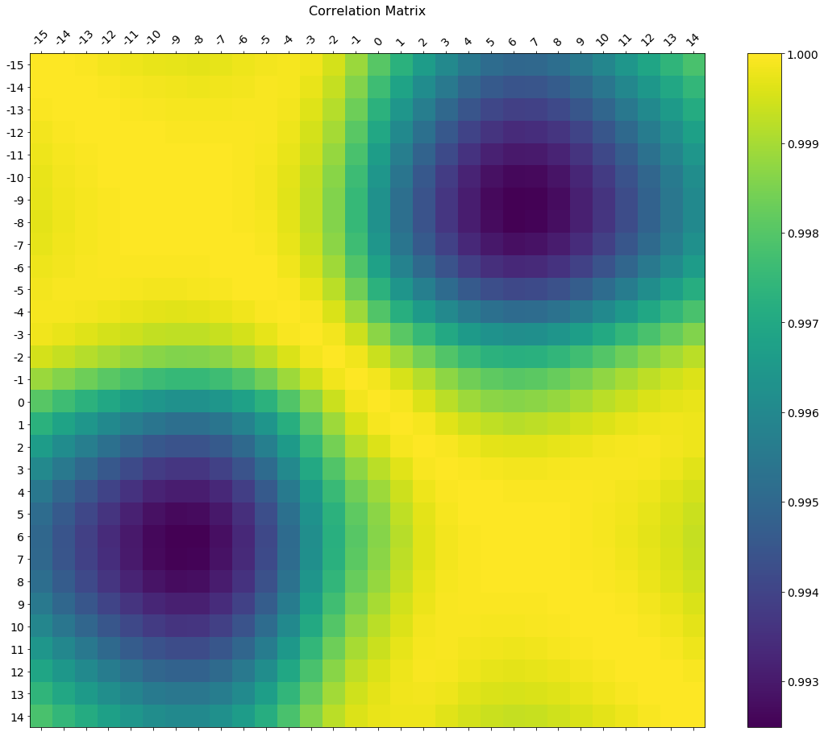
CORRELATION PEAK
A

Slide 12
VARIABLE DOPPLER (1)
SYM 1
SYM 2
SYM 3
SYM 1
SYM 2
SYM 3
SYM 1
SYM 2
SYM 3
SYM 1
SYM 2
SYM 3

Slide 13
VARIABLE DOPPLER (2)
SYM 1
SYM 2
SYM 3
SYM 1
SYM 2
SYM 3
SYM 1
PRN 1
PRN 2
PRN 3
PRN 4
PRN 5
PRN 1
PRN 2
PRN 3
PRN 4
PRN 5

Slide 14
VARIABLE DOPPLER (3)
SYM 1
PRN 1
PRN 2
PRN 3
PRN 4
PRN 5
PRN 1
PRN 2
PRN 3
PRN 4
PRN 5
COHERENT 1
COHERENT 1
COHERENT 1

Slide 15
VARIABLE DOPPLER (4)
SYM 1
PRN 1
PRN 2
PRN 3
PRN 4
PRN 5
PRN 1
PRN 2
PRN 3
PRN 4
PRN 5
COHERENT 1
COHERENT 2
COHERENT 3
ALMOST CONSTANT DOPPLER
IN EACH FRACTION

Slide 16
VARIABLE DOPPLER (5)
SYM 1
SYM 2
SYM 3
SYM 1
SYM 2
SYM 3
COH 1
COH 2
COH 3
COH 4
COH 5
COH 6
COH 7
COH 8
COH 9

Slide 17
VARIABLE DOPPLER (6)
SYM 1
SYM 2
SYM 3
SYM 1
SYM 2
SYM 3
COH 1
COH 2
COH 3
COH 4
COH 5
COH 6
COH 7
COH 8
COH 9
INCOHERENT 1
MAXIMUM CORRELATION
BEST TRACKING POINT

Slide 18
VARIABLE DOPPLER (7)
SYM 1
SYM 2
SYM 3
SYM 1
SYM 2
SYM 3
COH 1
COH 2
COH 3
COH 4
COH 5
COH 6
COH 7
COH 8
COH 9
COHERENT SYMBOL 1
COHERENT SYMBOL 2
COHERENT SYMBOL 3
KEPT PHASE INFORMATION
BEST DEMODULATION?

Slide 19
CAN WE TRACK THE VARIATIONS???

Slide 20
DOPPLER VARIATION (I)
SYM 1
SYM 2
SYM 3
SYM 1
SYM 2
SYM 3

Slide 21
DOPPLER VARIATION (2)
SYM 1
SYM 2
SYM 3
SYM 2
SYM 3

Slide 22
DOPPLER VARIATION (2)
SYM 1
SYM 2
SYM 3
SYM 2
SYM 3
????

Slide 23
DOPPLER VARIATION (3)
SYM 1
SYM 2
SYM 3
SYM 2
SYM 3
SYM 2
SYM 3
SYM 2
SYM 3

Slide 24
CORRELATION PEAK (1)
A

Slide 25
CORRELATION PEAK (2)
A
x

Slide 26
CORRELATION PEAK (3)
C
A
B
x

Slide 27
CORRELATION PEAK (4)
C
A
B
x

Slide 28
CAN WE DO BETTER???

Slide 29
CORRELATION PEAK (5)
????
????
A
x

Slide 30
CORRELATION PEAK (6)
h
E
g
C
A
B
j
F
i

Slide 31
CORRELATION PEAK (7)
h
E
g
C
A
B
j
F
i

Slide 32
PERIOD STRETCH (1)
SYM 1
SYM 2
SYM 3
SYM 2
SYM 3
SYM 2
SYM 3
SYM 2
SYM 3

Slide 33
PERIOD STRETCH (2)
SYM 1
SYM 2
SYM 3
SYM 2
SYM 3
SYM 2
SYM 3
SYM 2
SYM 3

Slide 34
PERIOD STRETCH (3)
SYM 1
SYM 2
SYM 3
SYM 2
SYM 3
SYM 2
SYM 3
SYM 2
SYM 3
SYM 2
SYM 3
SYM 2
SYM 3
SYM 2
SYM 3
SYM 2
SYM 3
SYM 2
SYM 3
SYM 2
SYM 3

Slide 35
PERIOD STRETCH (4)
SYM 1
SYM 2
SYM 3
SYM 2
SYM 3
SYM 2
SYM 3
SYM 2
SYM 3
SYM 2
SYM 3
SYM 2
SYM 3
SYM 2
SYM 3
SYM 2
SYM 3
SYM 2
SYM 3
SYM 2
SYM 3

Slide 36
SO COOL BUT IT WORKS???

